Slide 1

Helping Hands For Daily Needs

Slide 2


3rd Floor, Commerce Centre, Paud Road, Kothrud,
Opposite Krishna Hospital,Kothrud,
Pune, Maharashtra 411038
Presented By
Pranav Mohan Joshi (210543181074)
Nayan Uttam Dongare (210543181024)
Asawari Manik Kamble (210543181010)
Sakshi Vednath Choudhari (210543181088)

Slide 3
Modules
Objective
ER
Diagram
Flow
Fucture
scope
Photos

Slide 4

OBJECTIVES
1. In the day to day life we always face the maintenance problem in approximately every house. To overcome this kind maintenance problem we need plumbers, painters, fabricators, electricians etc.
2.From this project we are trying to provide the workers list which are currently available in our area.
3.Throughout this project we are trying to do customers life easy to finding out service provider as per their requirement

Slide 5

MODULES
Database
MySQL
Backend
Spring Boot
Frontend
HTML/CSS , JSP Pages,Jquery
Bootstrap

Slide 6
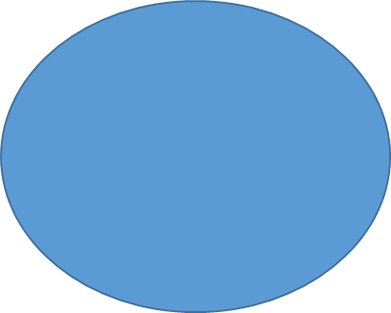


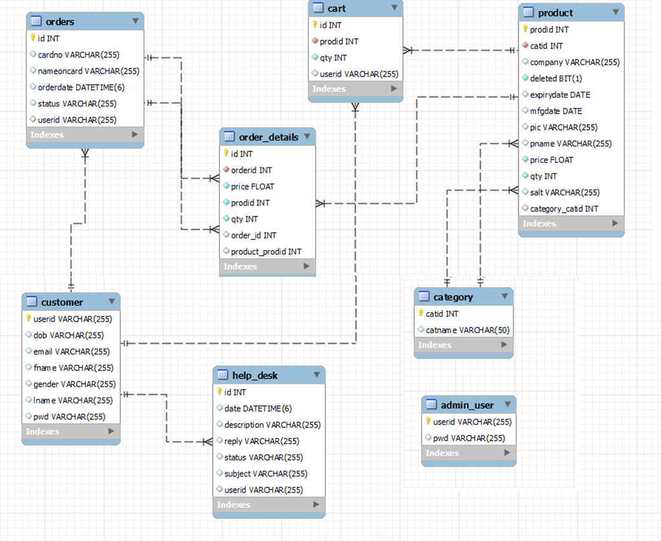

Slide 7

FLOW 1(Customer Flow)
Login
Category
Book Order
Invoice
Review

Slide 8
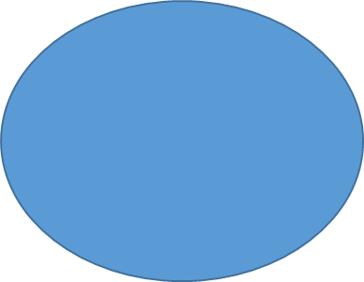

FLOW 2 (Admin Flow)
Login
Add Category
Add Worker
Conform Order
Reply Review

Slide 9
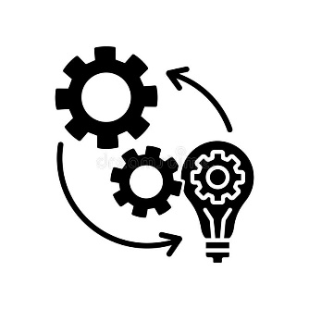
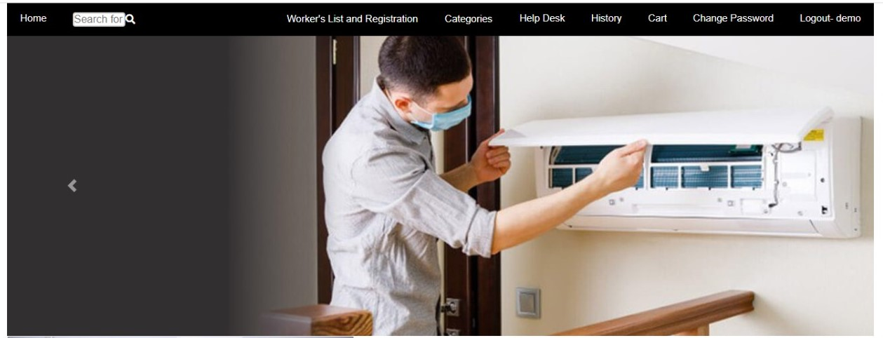
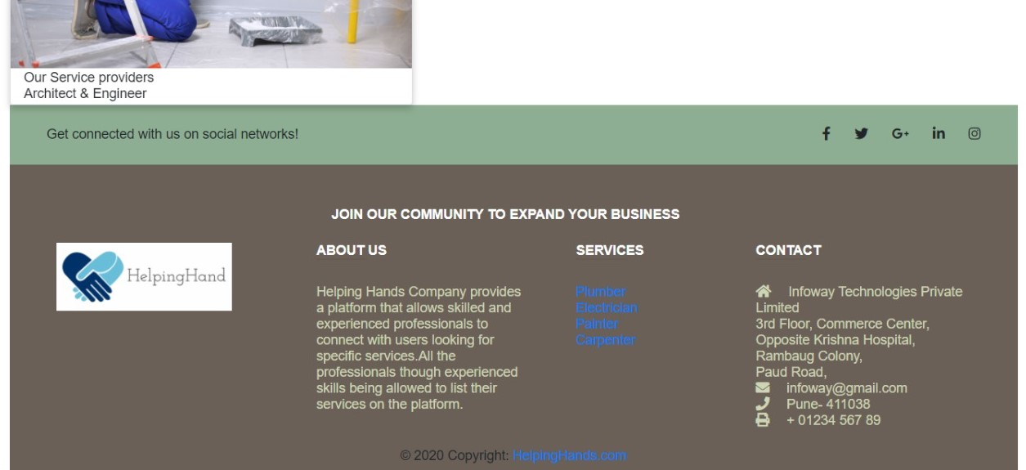
WORKS
Home page

Slide 10
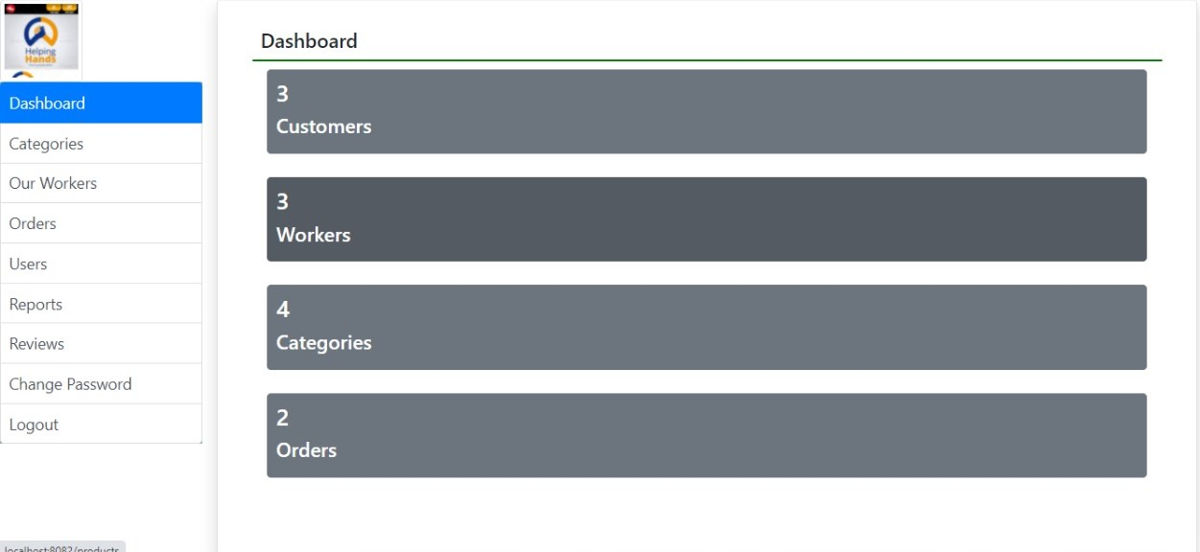
1.Admin Dashboard

Slide 11

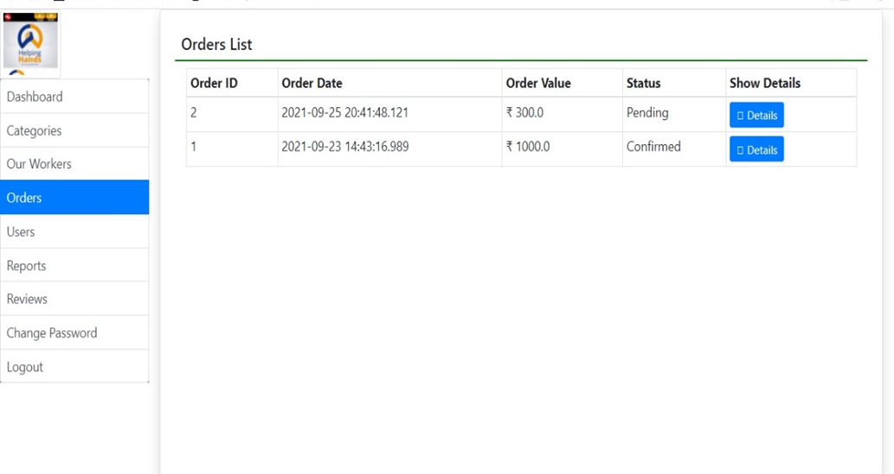
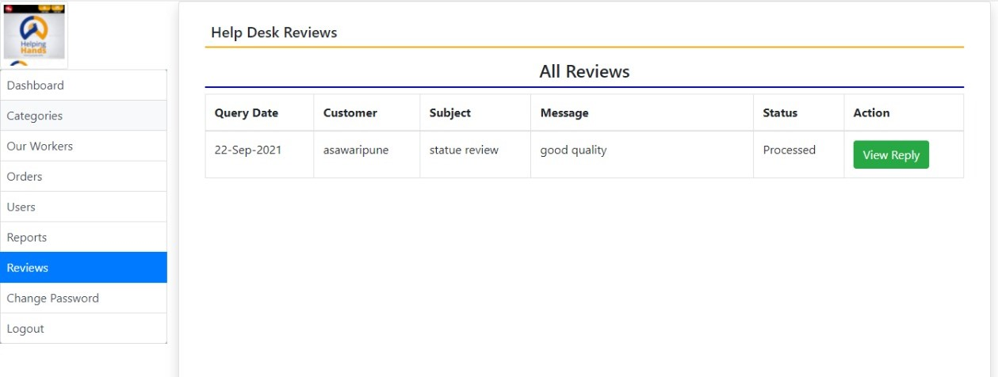
2.Order Conformation
3.Admin Reviews

Slide 12
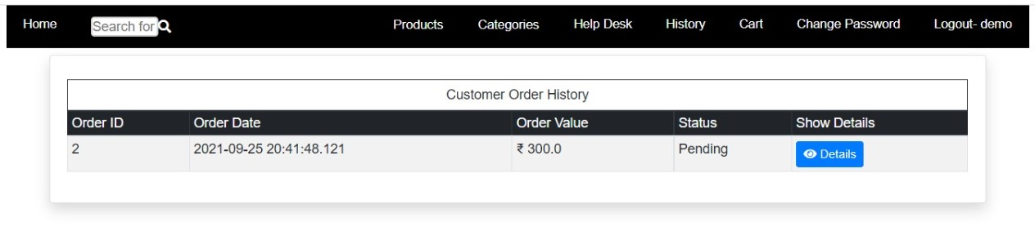
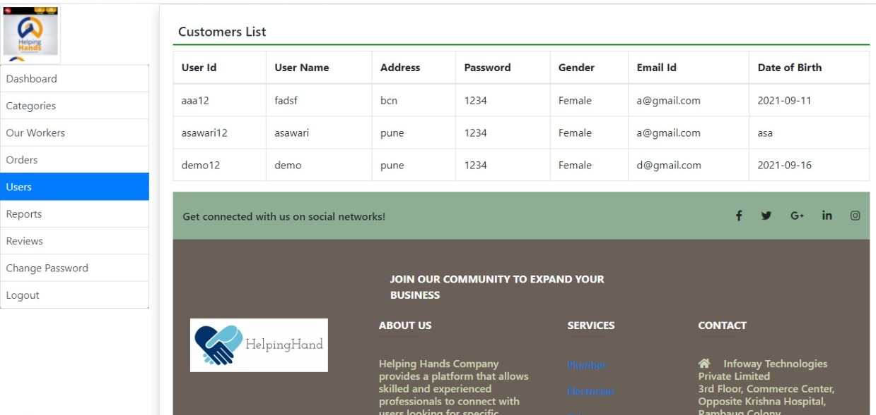
4.Customer Order History
5.Users List

Slide 13
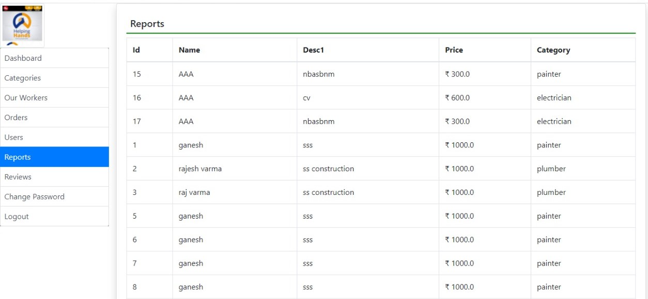
6.Workers List

Slide 14
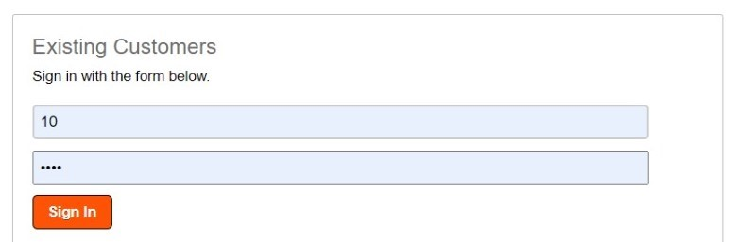
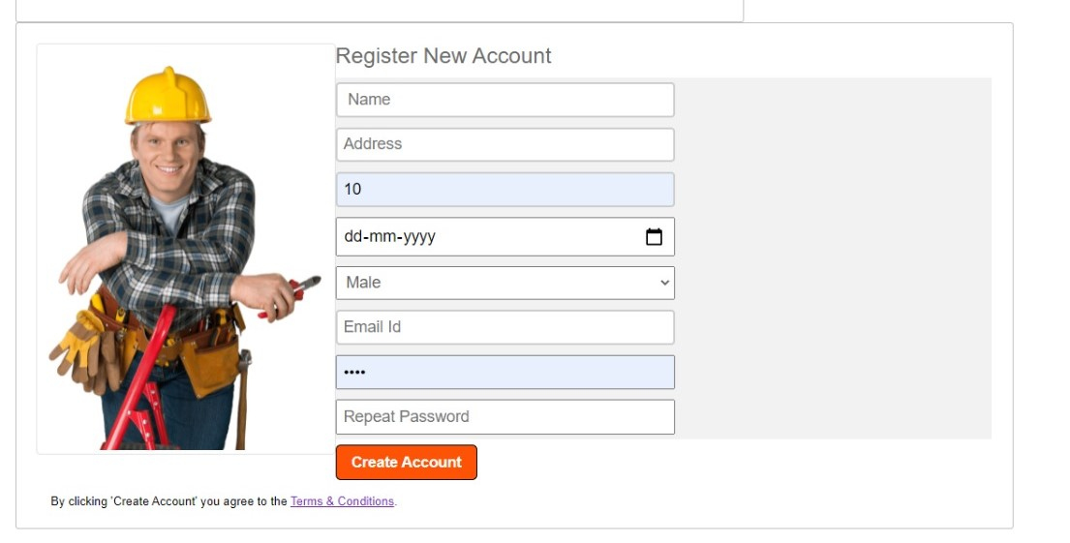
Login and Register Form

Slide 15

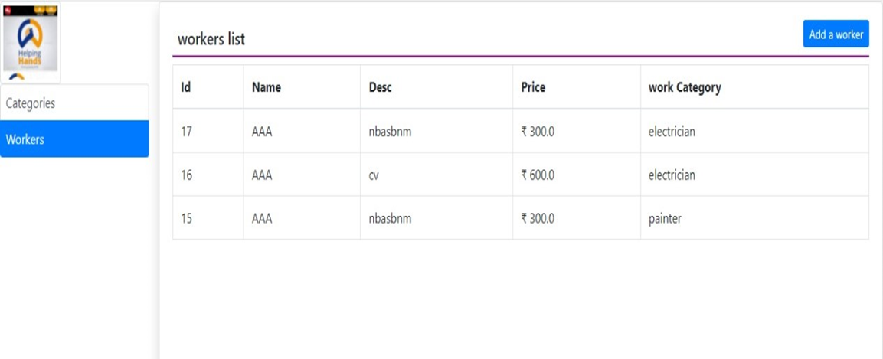

Slide 16
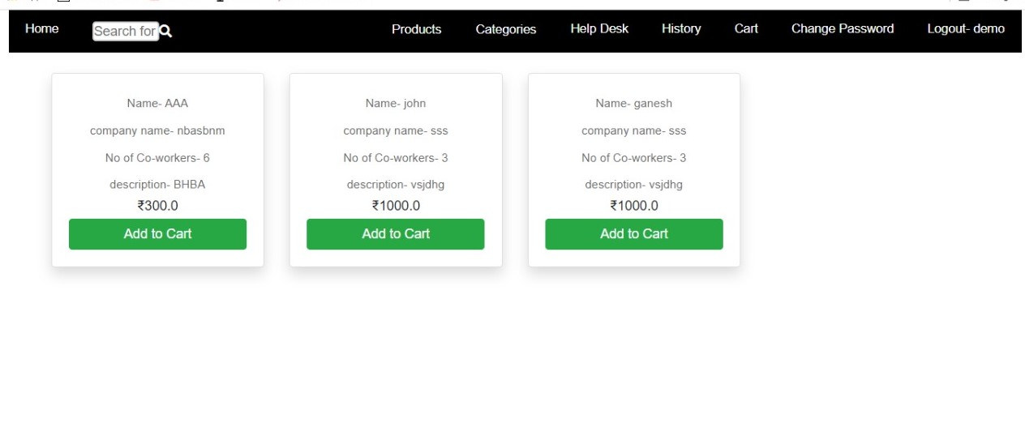
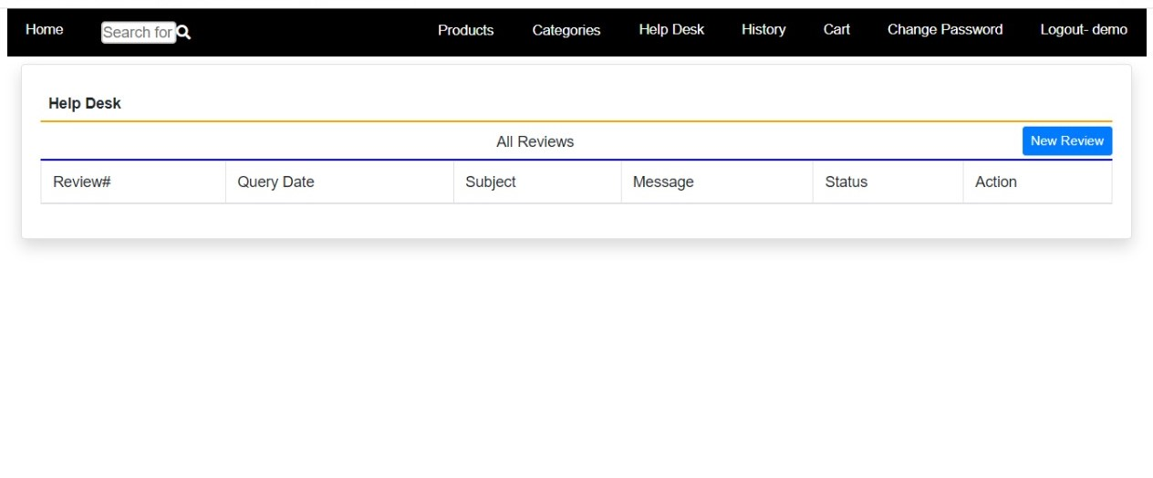
List of Cards
Review

Slide 17
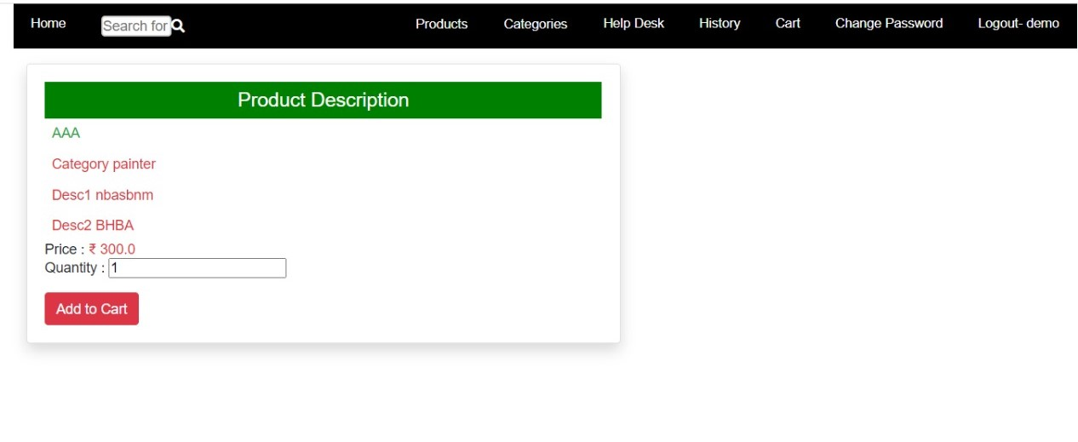
Product Description

Slide 18
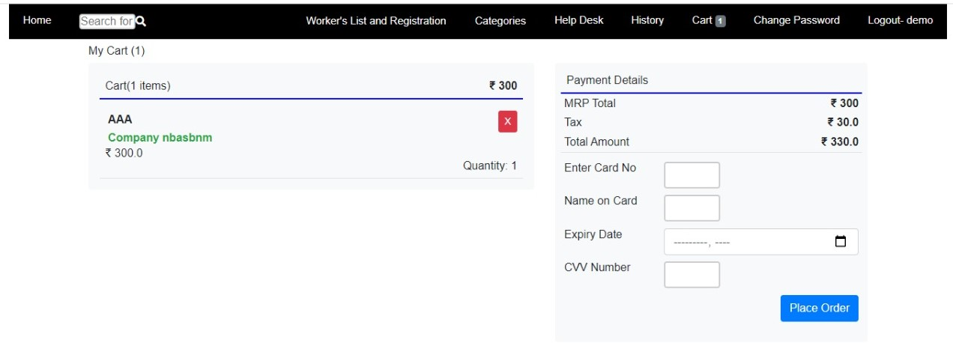
Payment

Slide 19
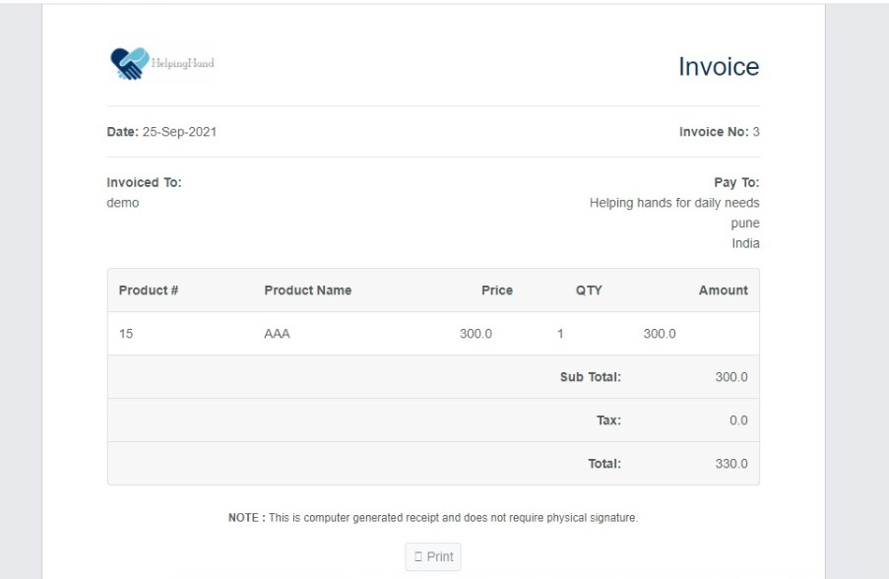
Invoice Page

Slide 20

FUCTURE SCOPE
1) Helping Hand for daily need provides a platform that allows skilled and
experienced professionals to connect with users looking for specific
services. All the professionals though experienced skills
being allowed to list their services on the platform.
2) The platform helps customers book reliable and high quality services
like, appliance repair, painting, electricians etc. delivered by professionals
conveniently available at the requested time and date at home.
3) Helping Hand for daily needs vision is to empower millions of professionals
worldwide to deliver services at home like never experienced before.
4) From this project any customer from any place will be able to book nearest
worker from his place. So that work will happen efficiently.
5) Provides hardware tools for respective services.

Slide 21
THANK YOU

